Slide 1
PROJECT ON MAKAAN APARTMENT PRICE ANALYSIS
By
P SRI Sai SATHVIK

Slide 2
INTRODUCTION TO THE WEBSITE
Makaan.com is a Real-estate website with services included Buy, Rent, Sell properties.
The website provides home loans and property services is a full stack service provider for all real estate needs
The website provides Makaan membership which includes exclusive privileges, it is user friendly and easy to understand and go through

Slide 3
AGENDA: Flow of the ppt
Problem Statement
Objective of the Project
Web Scraping – Details (Websites, Processor you followed)
Summary of the Data
Exploratory Data Analysis:
Data Cleaning Steps
Data Manipulation Steps
Univariate Analysis Steps
Bivariate Analysis Steps
Multivariate analysis
Key Business Question
Conclusion (Key finding overall)
Q&A Slide
Your Experience/Challenges working on Web Scraping – Data Analysis Project

Slide 4
ABOUT ME
Name : P. Sri Sai Sathvik
Qualification: B.Tech From GITAM
As we all know that we are living in a Data-Driven world, Any business, big or small is looking for skilled people in the field of Data-Science who can comprehend and deconstruct data. It is the very reason that, I have a natural bonding with Maths and Data.
Experience: Aspiring to become Data Analyst

Slide 5
Problem Statement
A problem statement is the clear description of the problem that you are trying to solve based on the client’s insight. This will be the starting point for decision making.
Key Problem statements:
What are the Locations having most no of properties?
What are the factors that is affecting the price of the property?
Why do we need to look at the Area_Sqft as in client’s best interest?
How to identify the number of apartments based on Area_Sqft and price, also on the City that the client

Slide 6
Objective Of The Project
Flats/Apartments Price Analysis based on several factors over Cities and Locations.

Slide 7
Web Scraping Details:
Website scraped: Makaan.com
Link :https://www.makaan.com/hyderabad-residential-property/buy-property-in-hyderabad-city
Libraries/Techniques used:
Data Collection → BeautifulSoup, requests, RegX.
Data Cleaning → Pandas, Numpy.
Data Visualization → Matplotlib, Seaborn.

Slide 8
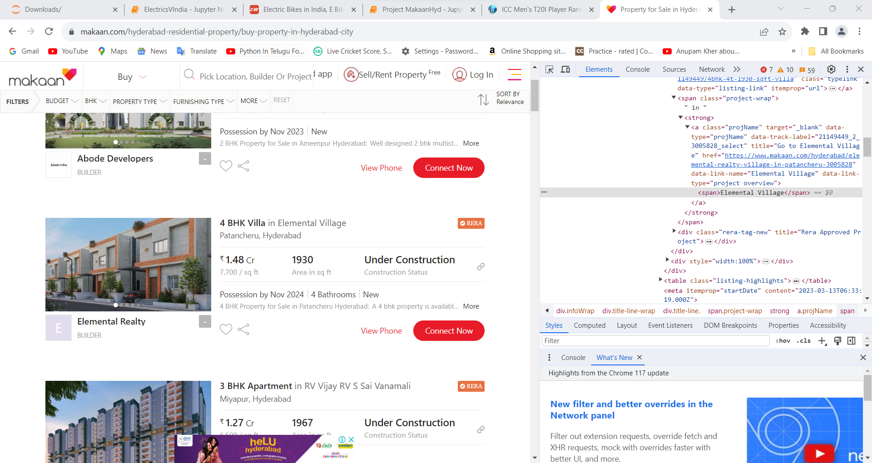
WEBSCRAPPING

Slide 9
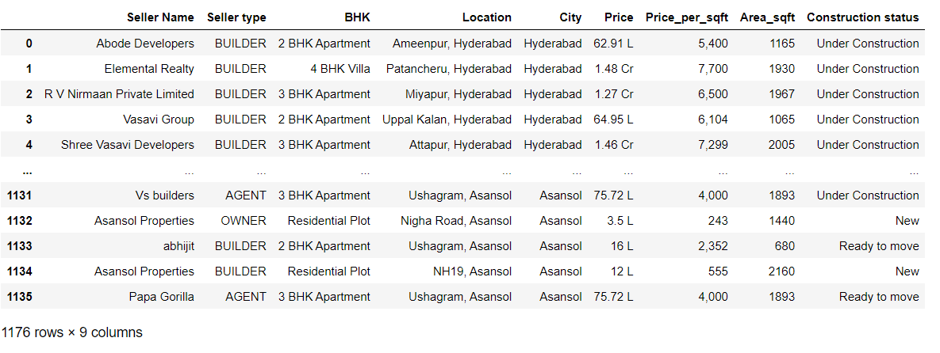
Raw Data Collected:

Slide 10
Summary Of The Data
The Data-Collected is a raw data from MagicBricks.com which contains Null-Values(NaN’s), Empty spaces and Corrupted data. The total number of rows obtained are and columns are 8.
Initially the Data will be of dtype → object, we need to clean the data and convert them into their respective dtypes.
The Column Variables are:
1. City
2. Location
3. Seller_Name
4. Seller_Type
5. BHK
6.Price
7.Area_Sqft
8.Price_per_sqft
9. Construction Status

Slide 11
Data Cleaning Steps:
Data Cleaning Involves the following steps:
Step 1: Check for Duplicates:
Find the Duplicates and drop them, keep preference as first.
Step 2: Identify the Corrupted Data:
Remove the Corrupted values, symbols or text etc..,
Step 3 : Handling missing values:
Identify missing values using `isna()` or `isnull()`
View the missing values
Replace the missing values after changing the dtypes of the columns with respective Statistical Measures i.e.,, Mean(), Median(), Mode().
Step 4 : Handling Outliers:
Find the skewness for each column and based on the value move forward.
Identify the Outliers using IQR method or Z-score method and view them.

Slide 12
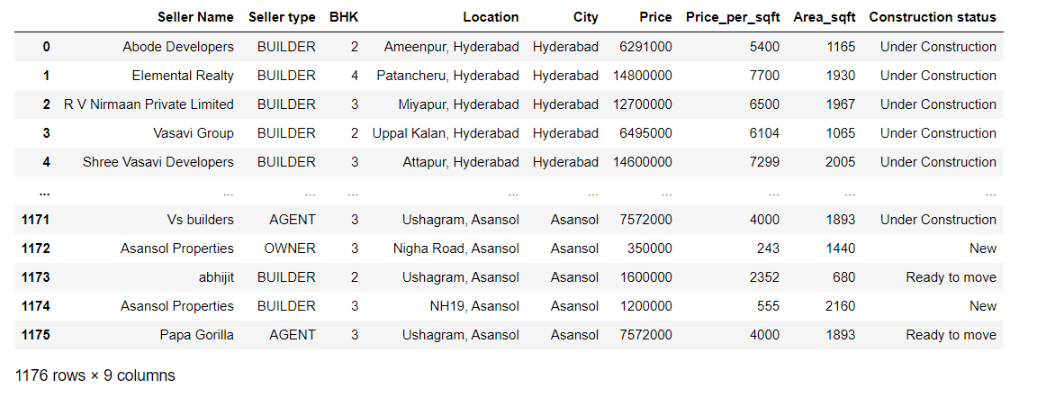
Cleaned Data:

Slide 13
Data Manipulation
Data Manipulation contains the following steps:
Type Casting of Data Frame columns to the respective dtypes.
Filtering the Dataset according to the need for better understanding.
Data Frame operations like `Column Renaming`, `Dropping rows and columns`, `Resetting index` etc..,
Sorting the data in a data frame.
Applying string operations, Array operations , list operations etc.., on the data.

Slide 14
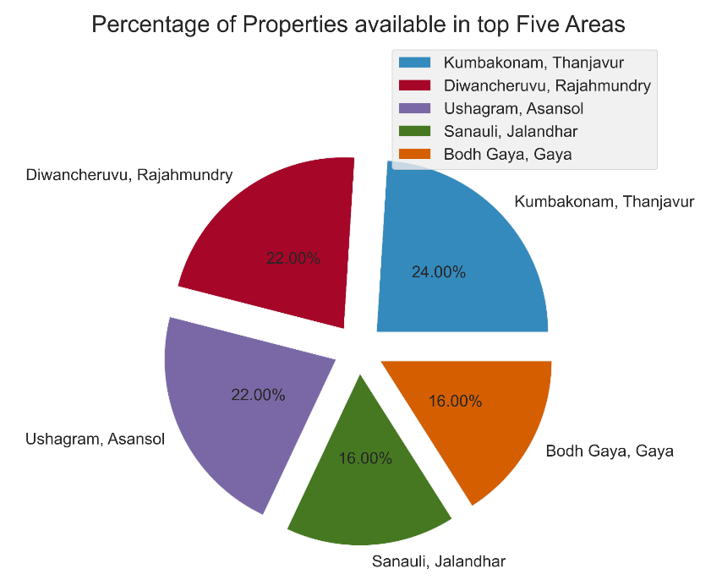
Univariate Analysis
The analysis of single variable at a time with the aim of analyzing the distribution of the variable in the data often equated with descriptive analysis.
Observation:
Each slice in the following pie chart represents the percentage of overall properties available in top 5 area’s in my dataset, It is observed that Kumbakonam is having more no of properties and Second highest is Diwancheruvu under Rajahmundry .

Slide 15
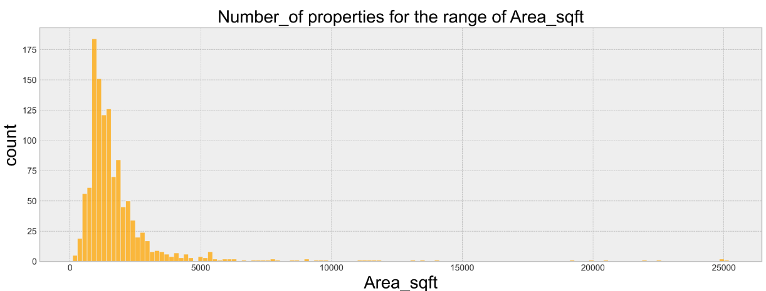
Observation:
From the above histogram it is observed that up to 75% of the apartments are lie between the Carpet Area 500 – 2500 Sqft.

Slide 16
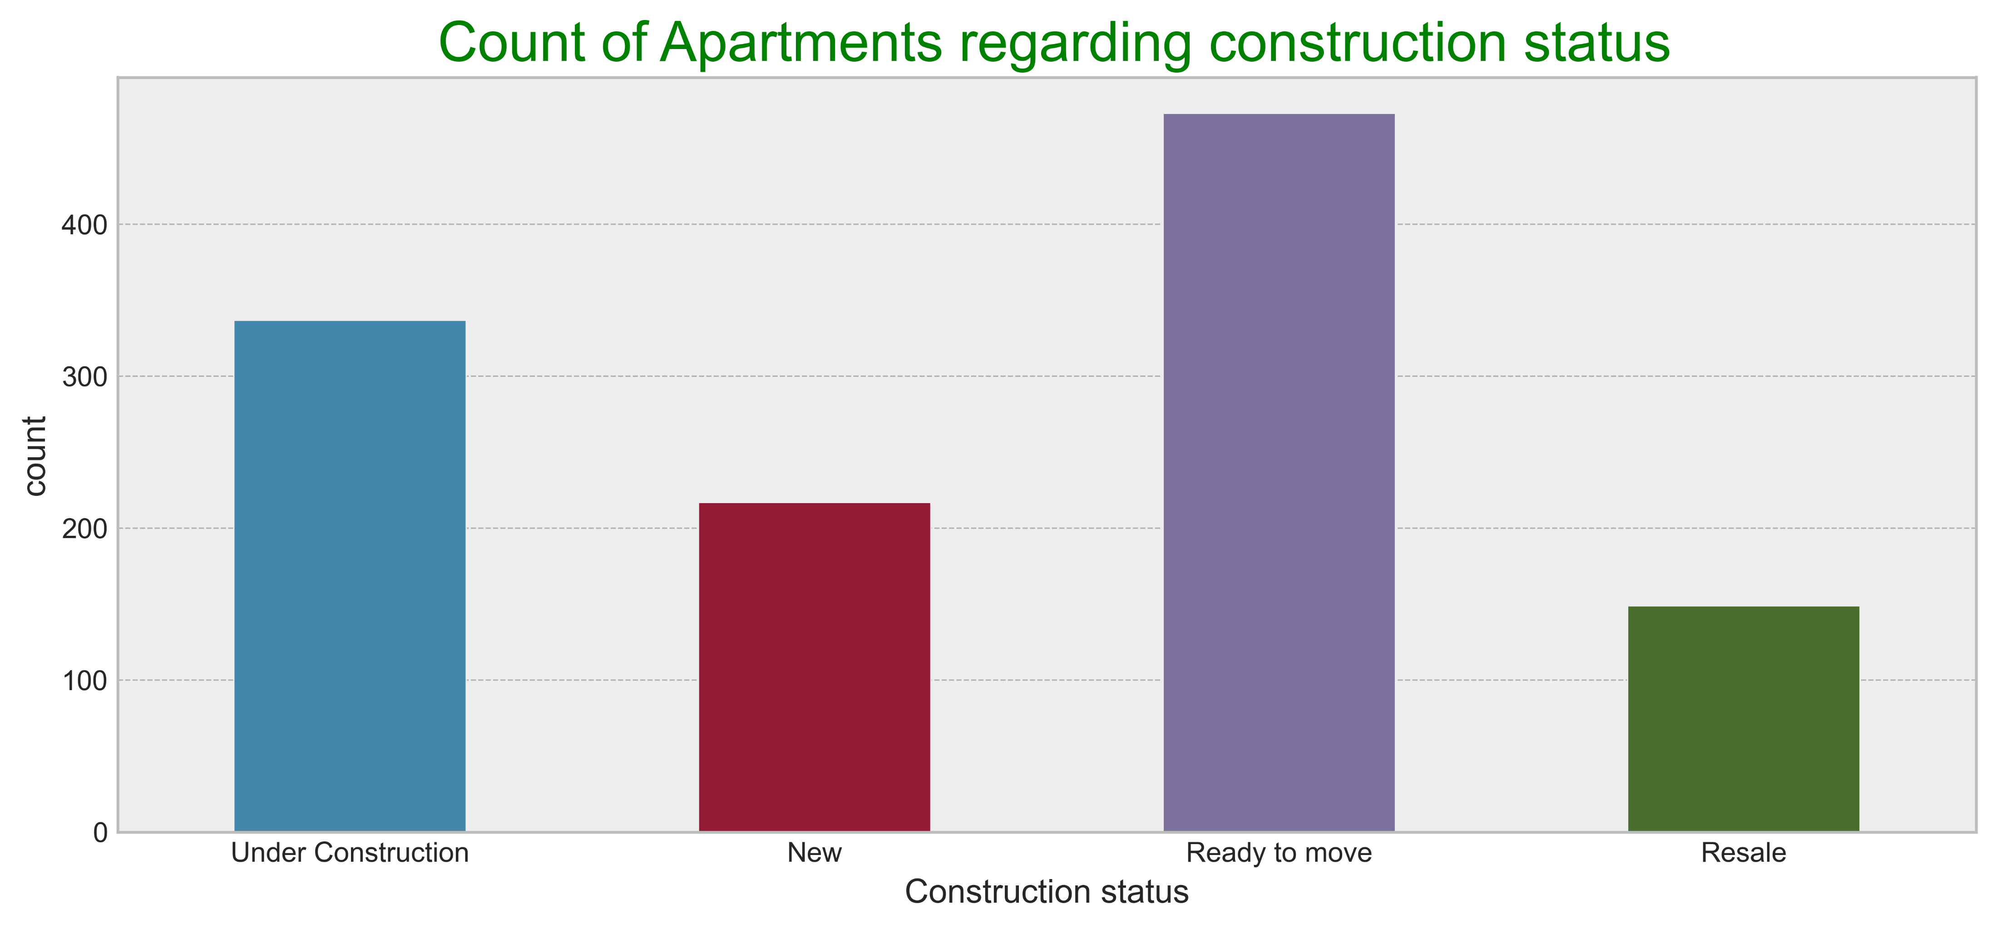
Observation:
1. From the above histogram it is observed that up to majority of the apartments are getting sold under Ready to move construction status

Slide 17
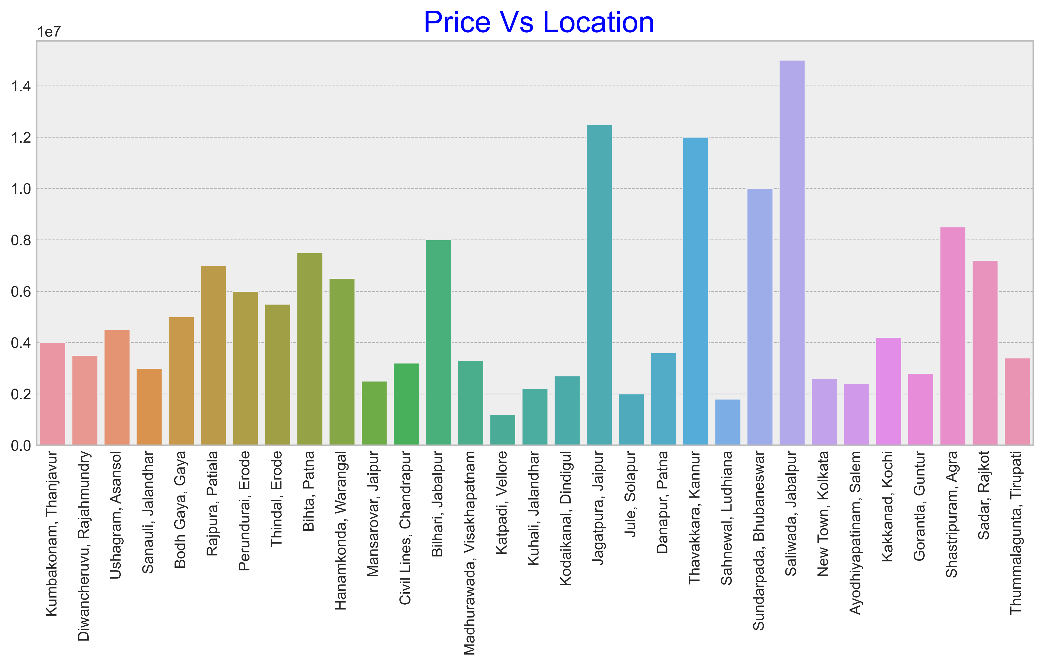
Bivariae Analysis
Observation:
1. The bar plot will enlighten us regarding the price analysis based on locations, As said it is observed that Saliwada under Jabalpur is having highest price for apartments
2. Katpadi under Vellore is having least price for apartments

Slide 18
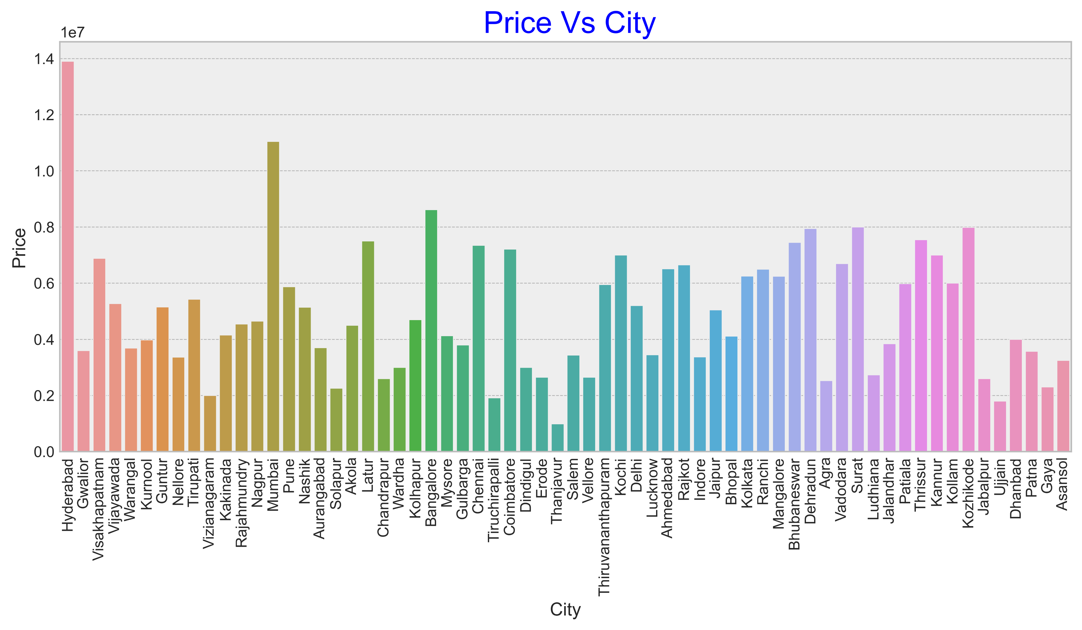
Observation:
1. The bar plot will enlighten us regarding the price analysis based on Cities, As said it is observed that Hyderabad is having highest price for apartments
2. Thanjavur is having least price for apartments

Slide 19
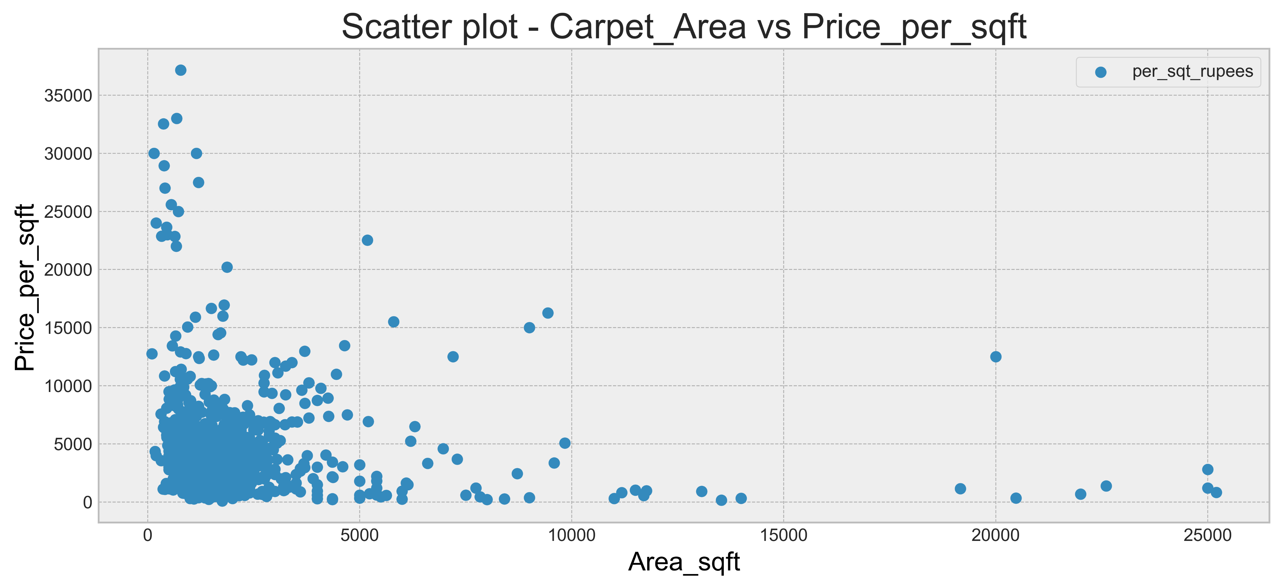
Observation:
From the above histogram it is observed that up to 80% of the apartments are lie between the Carpet Area 1000 – 5000 Sqft are having per sqft price between 2500 – 15000 per sqft

Slide 20
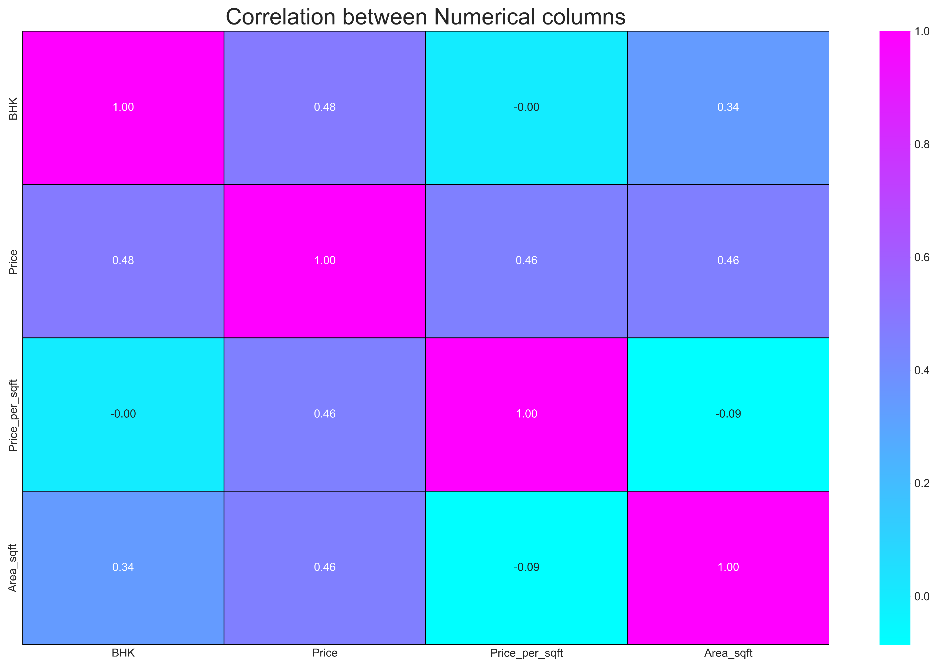
Multivariate Analysis
Observation:
BHK Vs Area_Sqft is having positive correlation as you can see in the heat map
as BHK increases the carpet area also increasing.
2. Price_Per_Sqft rupees vs. price is also having little bit of positive correlation.
3. Price_Per_Sqft rupees vs. Area_Sqft having high negative correlation.

Slide 21
CONCLUSIONS:
From the EDA and Data Visualization the following conclusions are drawn:
1. Kumbakonam having more no of Flats/Apartments 24.00% of the overall dataset.
2. From the above analysis Hyderabad city is having highest price range for Flats/Apartments and Lowest in Thanjavur city.
3. It is concluded that up to 70% of the Flats/Apartments are off 2BHK and in the price range of 0 to 2 crore.
4. Up to 80% of the Flats/Apartments are having a carpet area range of 1000 – 5000 Sqft having 2500-15000 price per sqft
5. Based on the EDA ,Data visualizations and conclusions that are drawn I believe it is clear that my client can comfortably find the Flat/Apartment of his financial factors.

Slide 22

THANK YOU

